Slide 1


🎼 Recorod Shop Inventory App
Takako Onozuka

Slide 2


Meet my clinent
Name: Richard G
Age: 72
Location: Ayr, South Ayrshire
Occupation: Semi-retired / Runs a small record shop, Seaside Records, both in person and online.
Lives with: Partner and two dogs

Slide 3
Meet my clinent
I want something to organise my record stocks.
My eyesight is not in the best condition, so I’d like something simple and easy to understand.

Slide 4
What Richard can do with Record Shop Inventory App
BASIC funtions:
View all the records in stock
View all the artists in the database
View all the genres in the database
View all the records by a genre
View all the records by an artists
Add / edit a records
Add / edit an artists
Create a new genre
View details of each records / artists, with edit option

Slide 5

What Richard can do with Record Shop Inventory App
PLUS funtions:
Gets “low stock” notification when the stock is less than 3
View a markup for each record
View artists in alphabetical order
Contact me if there is any issues
One of Richard’s dogs, Connie

Slide 6
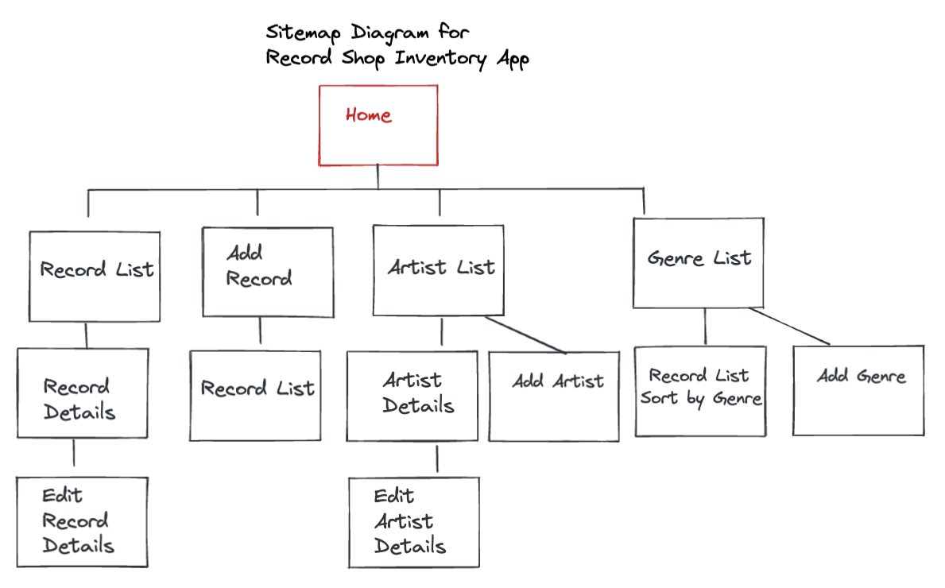

Slide 7
The memorable codes for Record Shop Inventory App

Slide 8

Next Step For Record Shop Inventory App
Add “View Sales” page to see monthly / weekly sales and profit.
Add “Image Upload” on ”Add Record” page, so images of each record will appear on the record list

